Slide 1
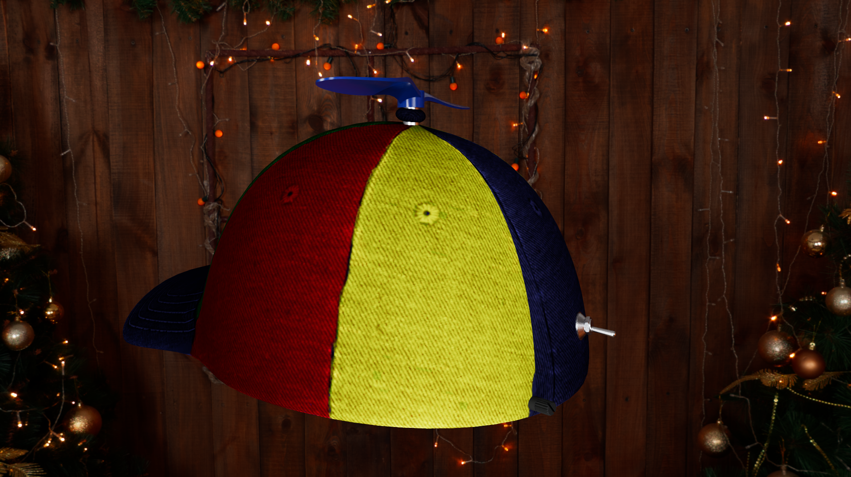
Propeller Hat
The Future of Transportation

Slide 2
Description
Unique
Equipped with a small propeller on top
Controlled using a phone app or physical dial
Great conversation starter
Lots of fun to use

Slide 3
How it Works

Slide 4
The App
The app uses the BlunoLibrary, provided by DFROBOT, the manufacturer of the Bluno Beetle BLE, to connect to the hat.
The app’s interface has several buttons:
A scan button, four speed presets, and a slider bar.
And a tremendous logo to remind you of what you’re controlling.

Slide 5
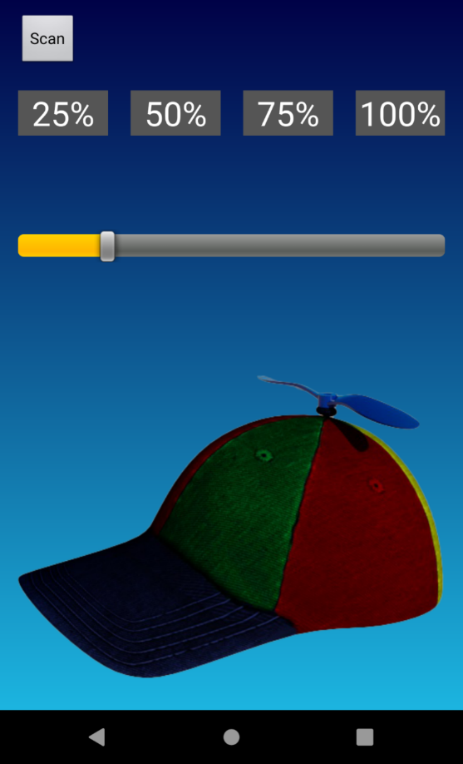
The UI

Slide 6
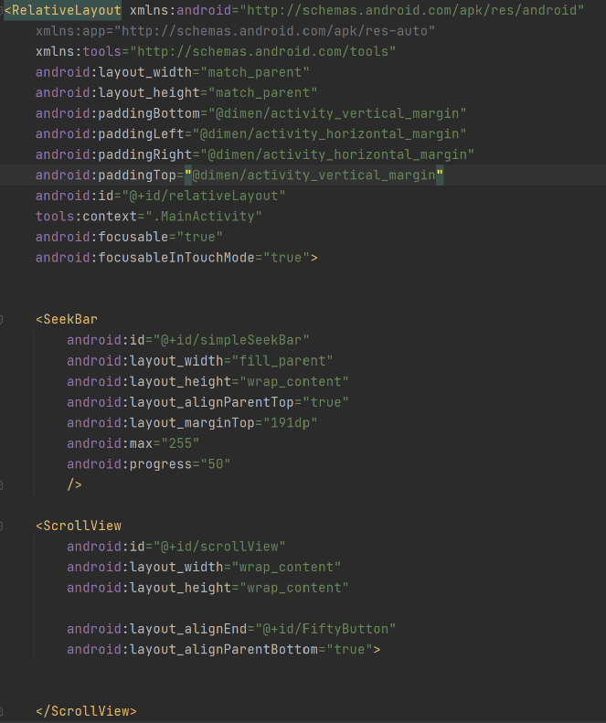
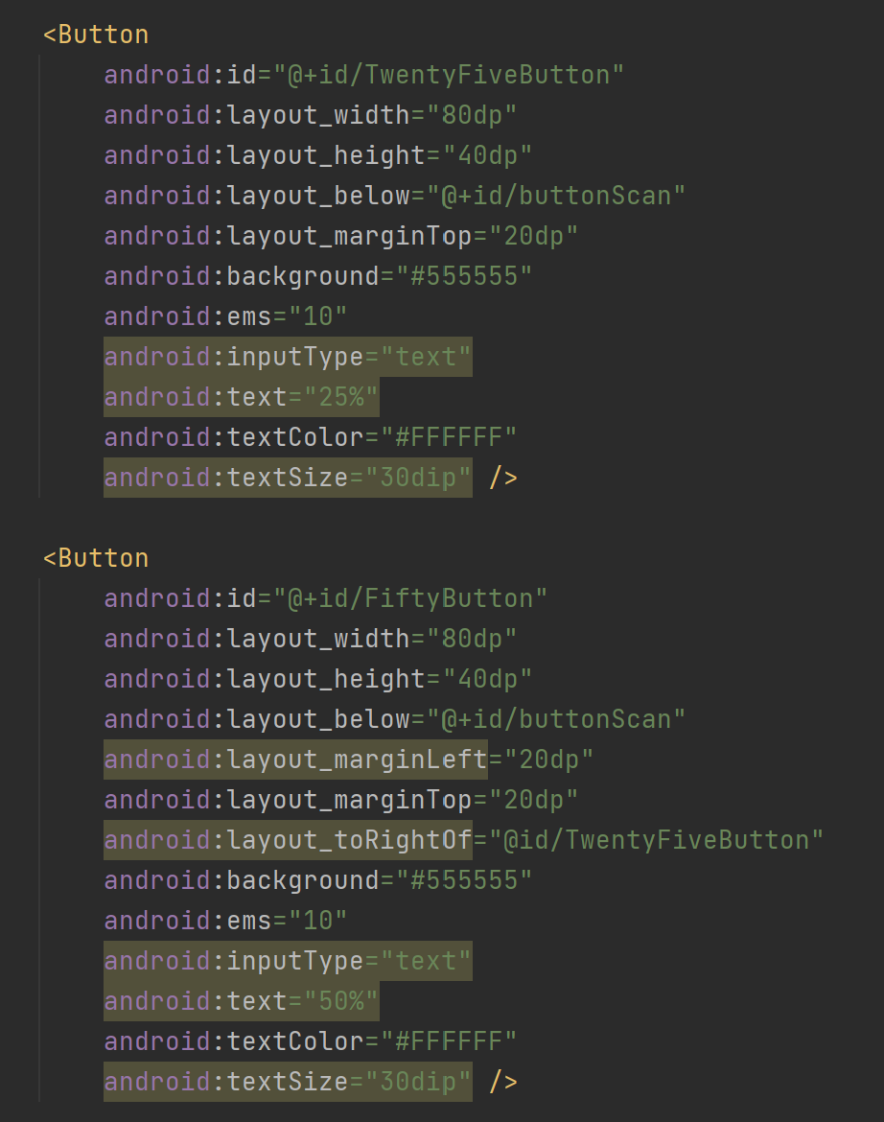
Layout(activity_main.xml)
Create button for 25% speed
Initializing the window
Make background of button grey
Slider(seekbar) look and style
Make text white
Max value of the bar is 255
Create button for 50% speed
Bar starts at “50” position
It must be to the right of “25%”

Slide 7
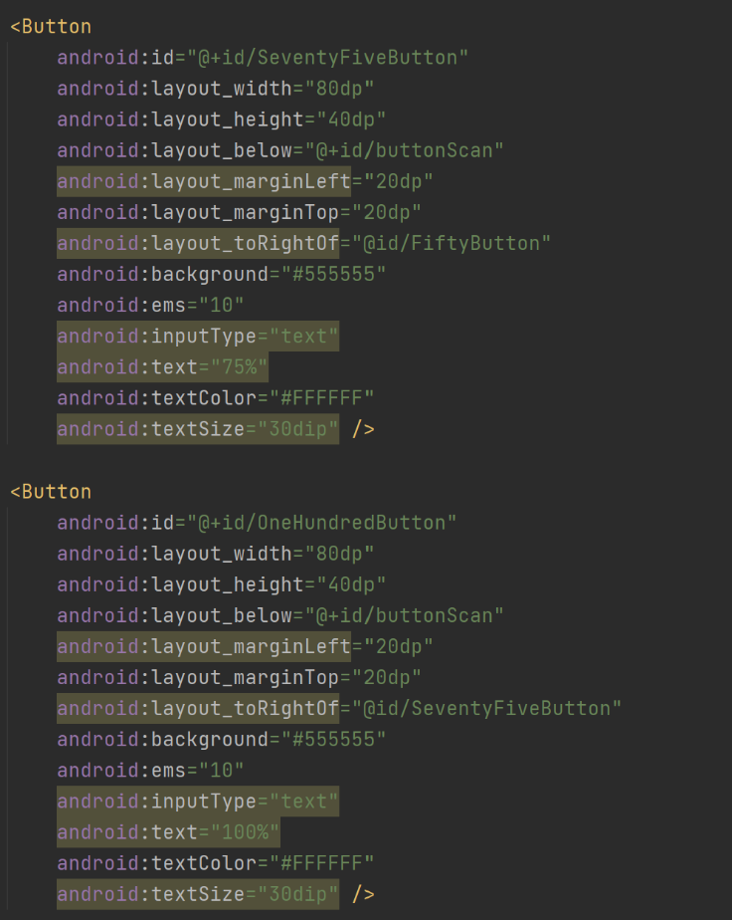
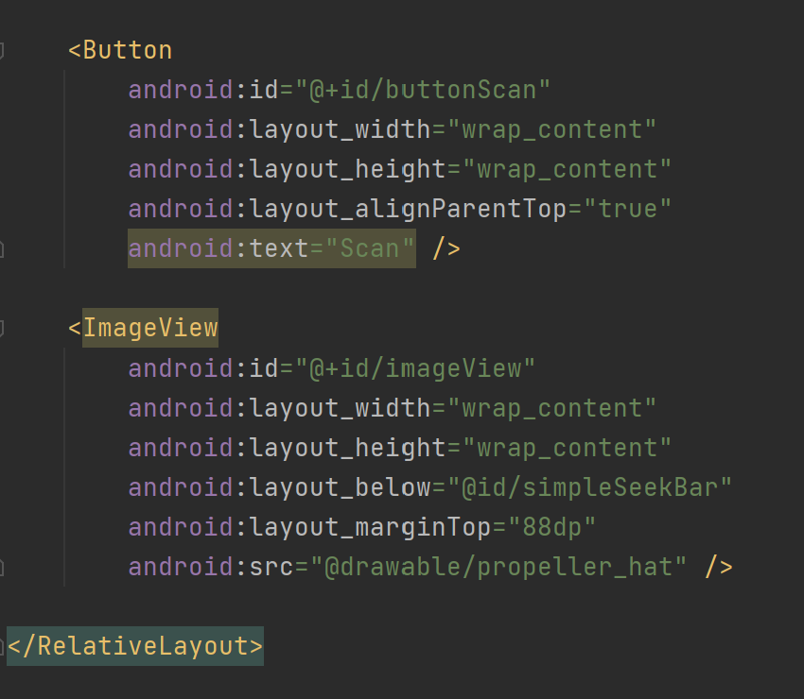
Create button for 75% speed
Button called “Scan” which will begin the search for Bluetooth devices.
It must be to the right of “50%”
Rendered logo of the propeller hat placed below the slider bar
Create button for 100% speed
It must be to the right of “75%”

Slide 8
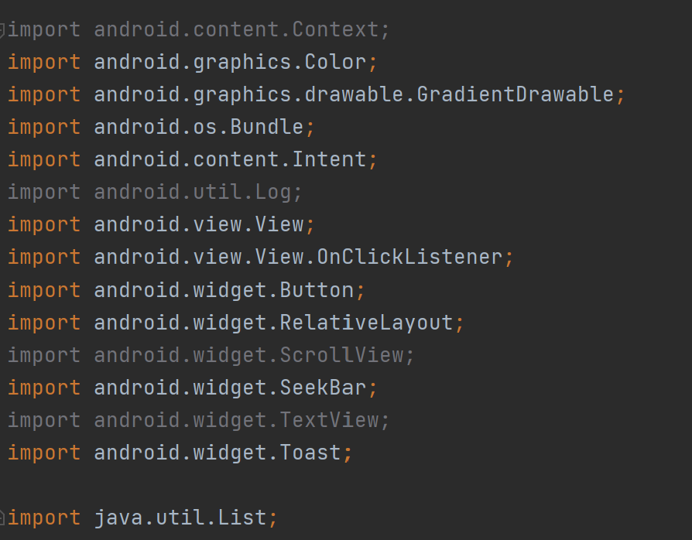
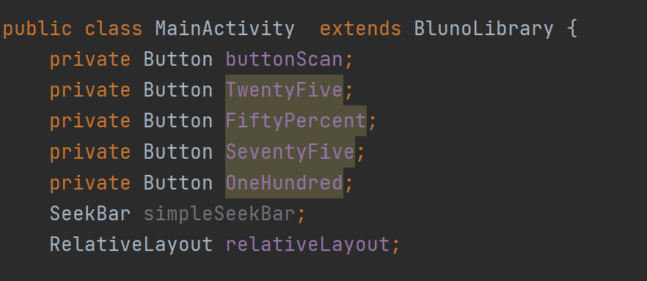
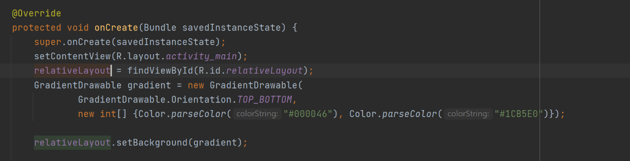
Main Class
Extend the Bluetooth library provided by the developer board manufacturer
Android classes used
Initialize the Buttons
Set the content view
Make the app background a gradient known as “outrun”

Slide 9
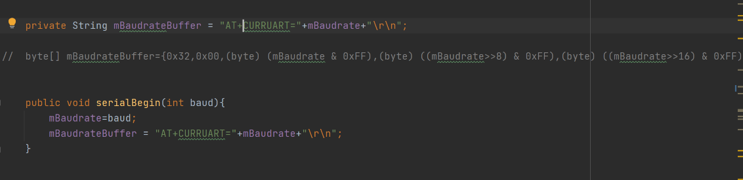
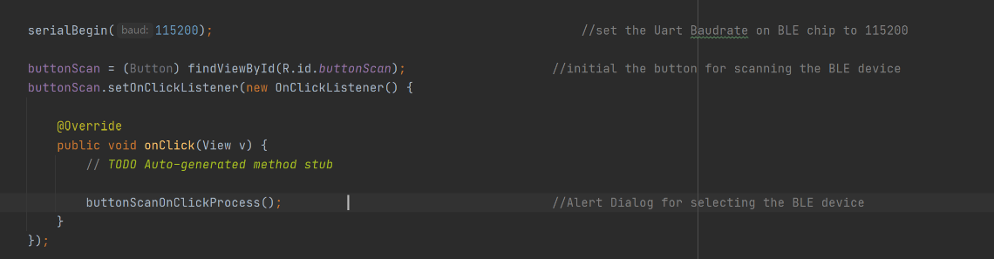
Main Class Continued
Begin a serial connection with a baud rate of 115200 as recommended by DFROBOT

Slide 10
Hardware

Slide 11
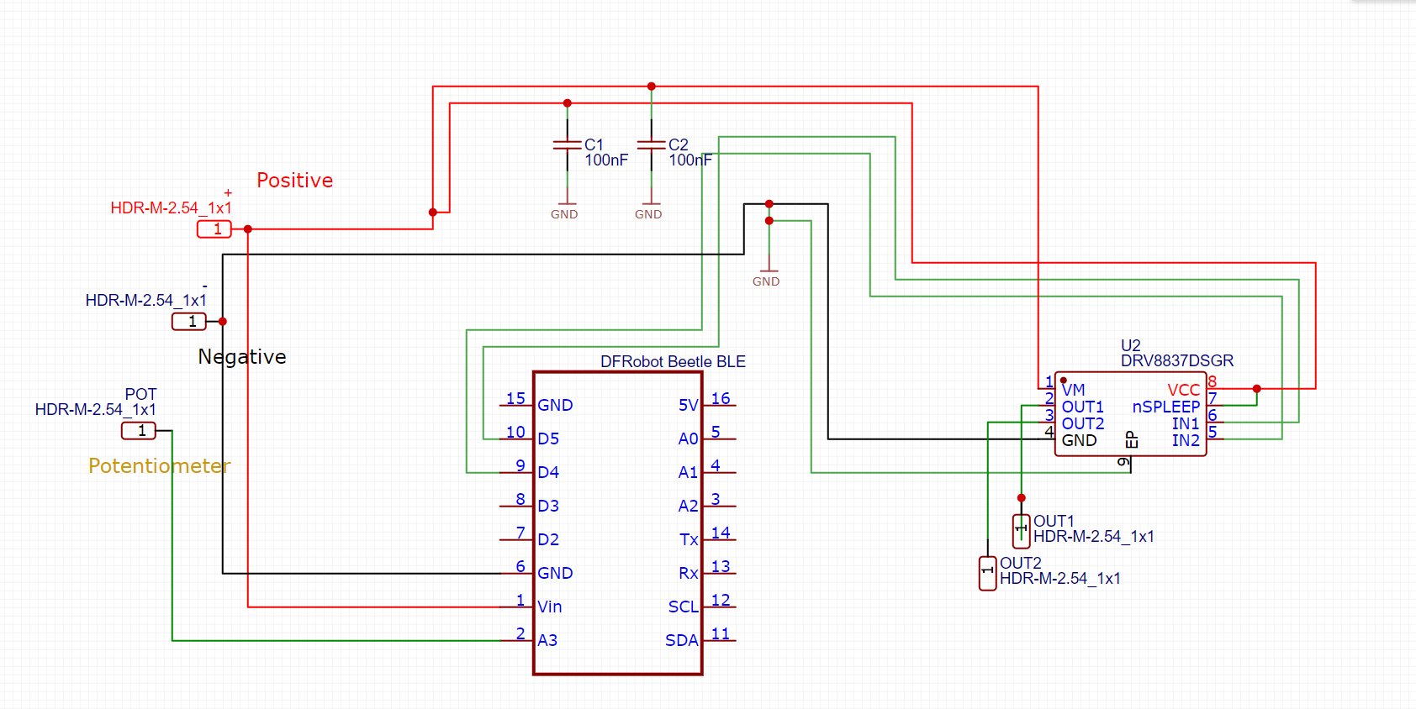
The Circuit

Slide 12
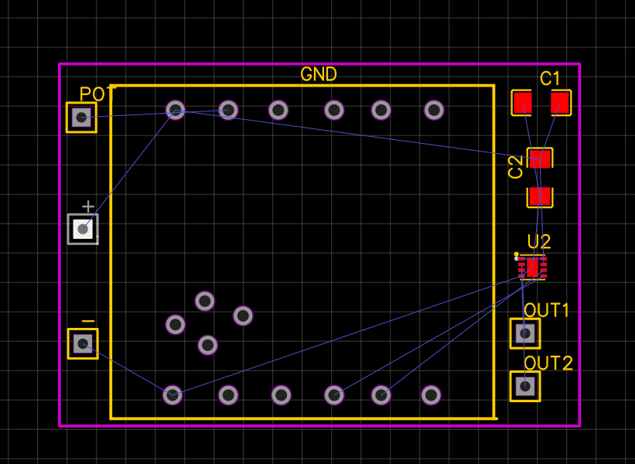
The PCB

Slide 13
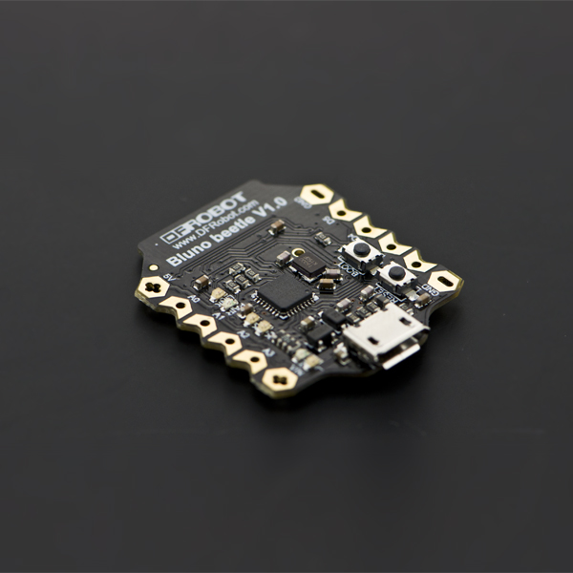
The Processor

Slide 14
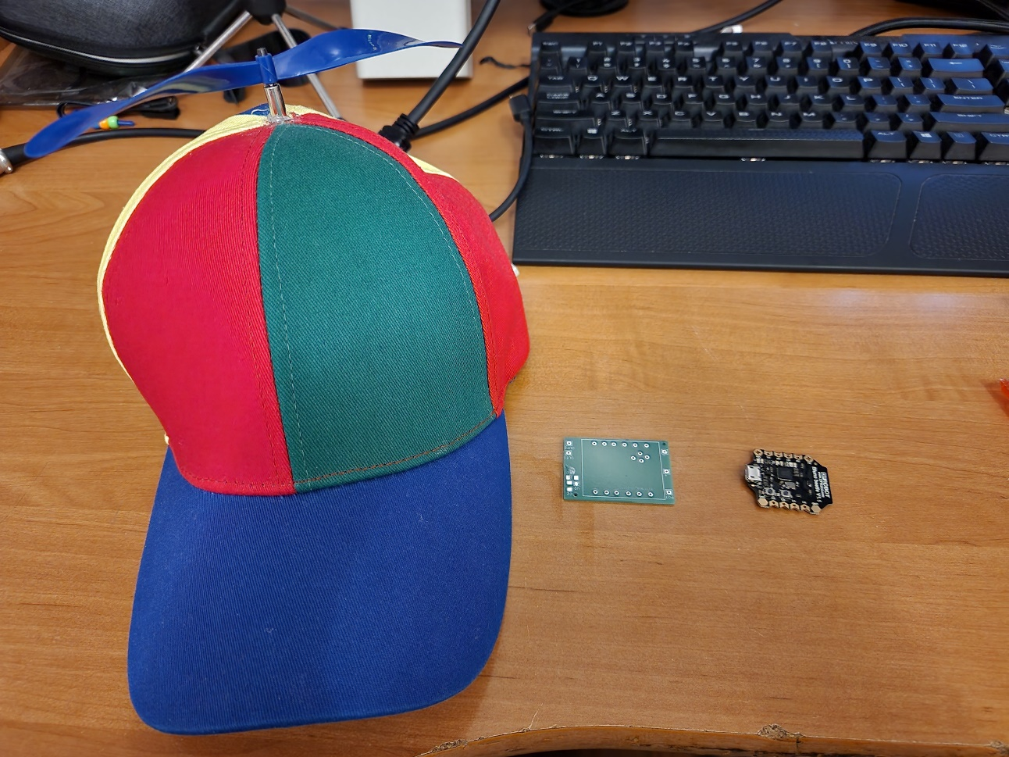
Time to Build

Slide 15
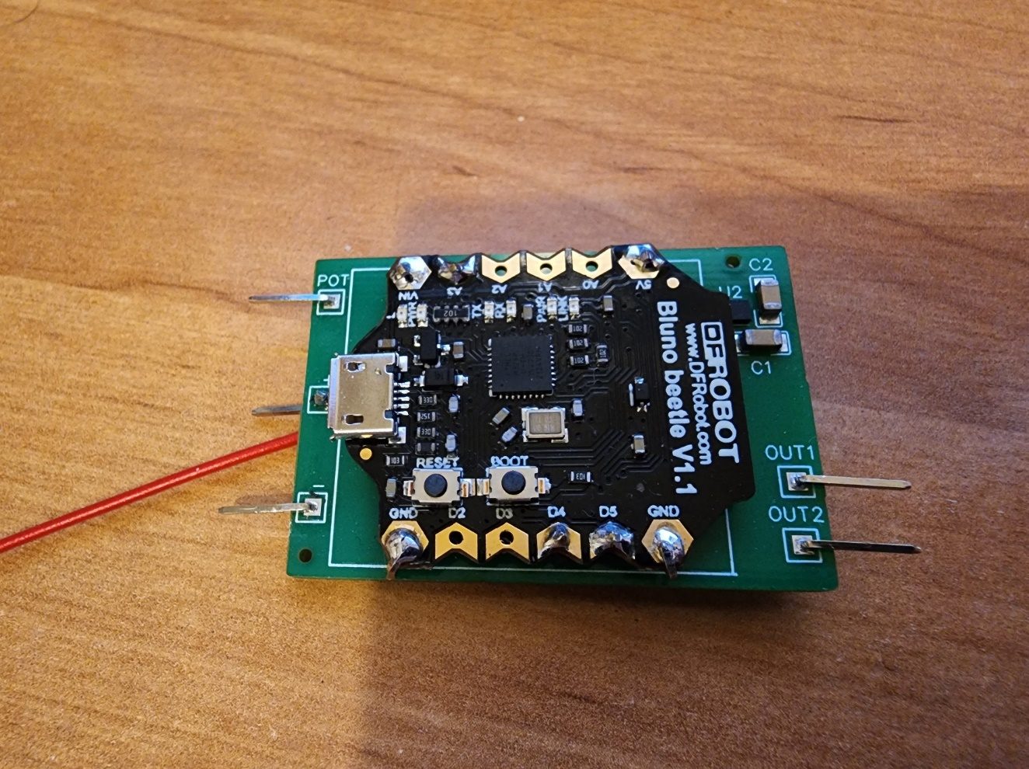
Finished board

Slide 16
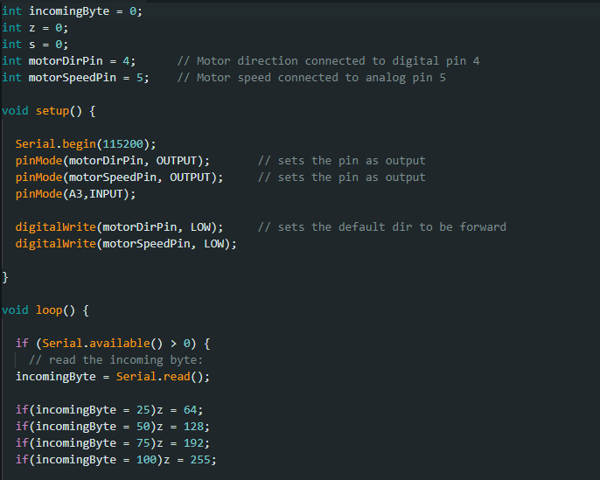
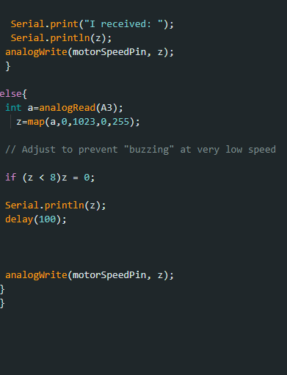
Arduino Code

Slide 17
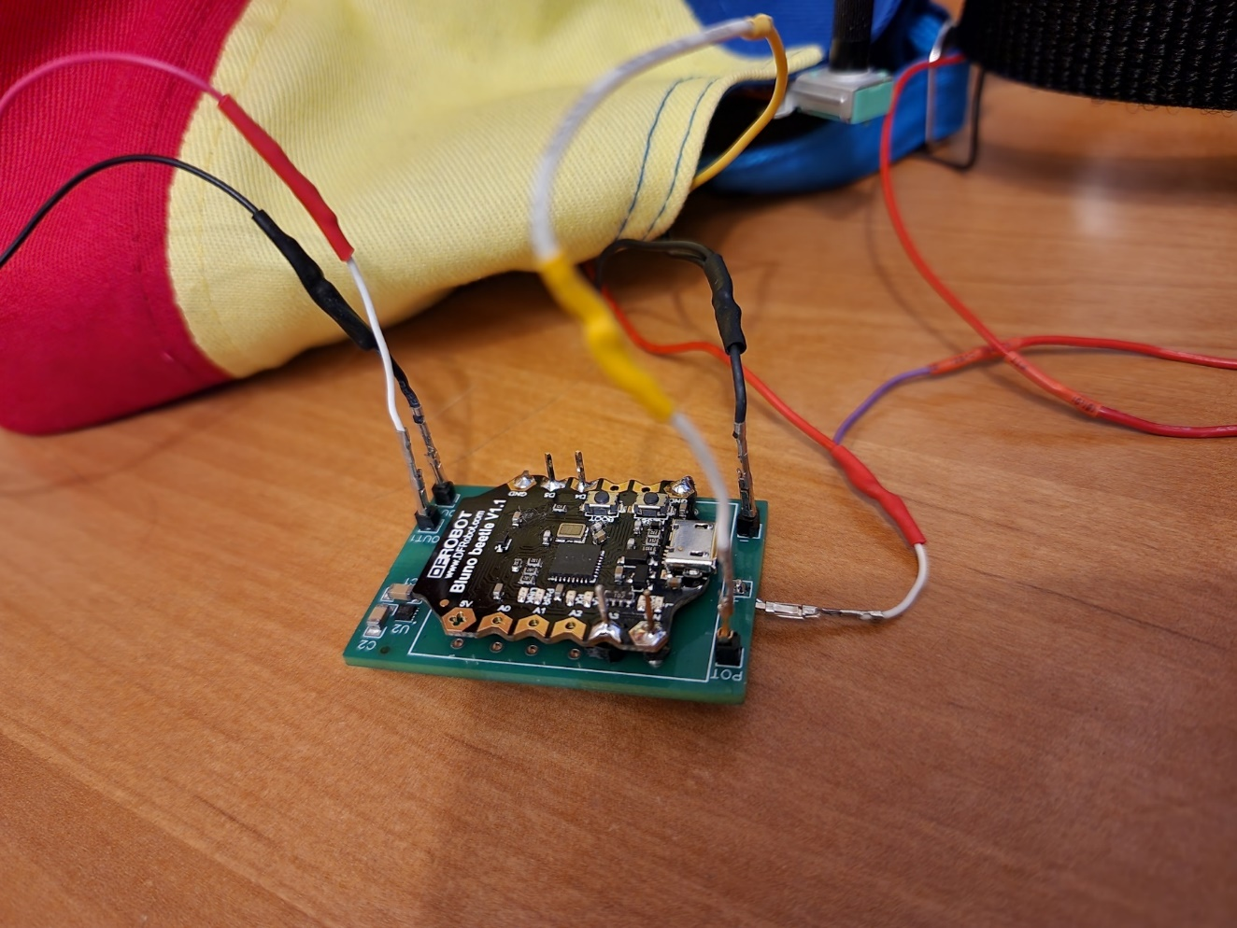
Testing

Slide 18
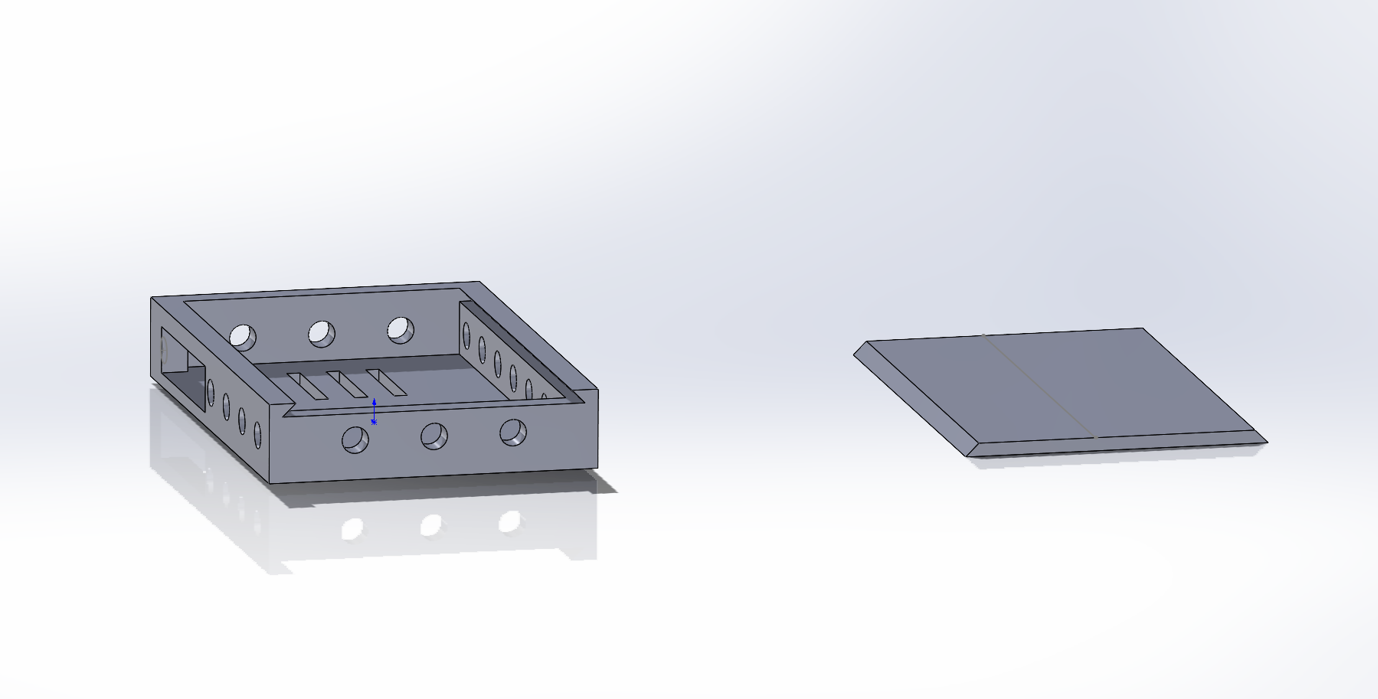
The Enclosure
Version 1

Slide 19
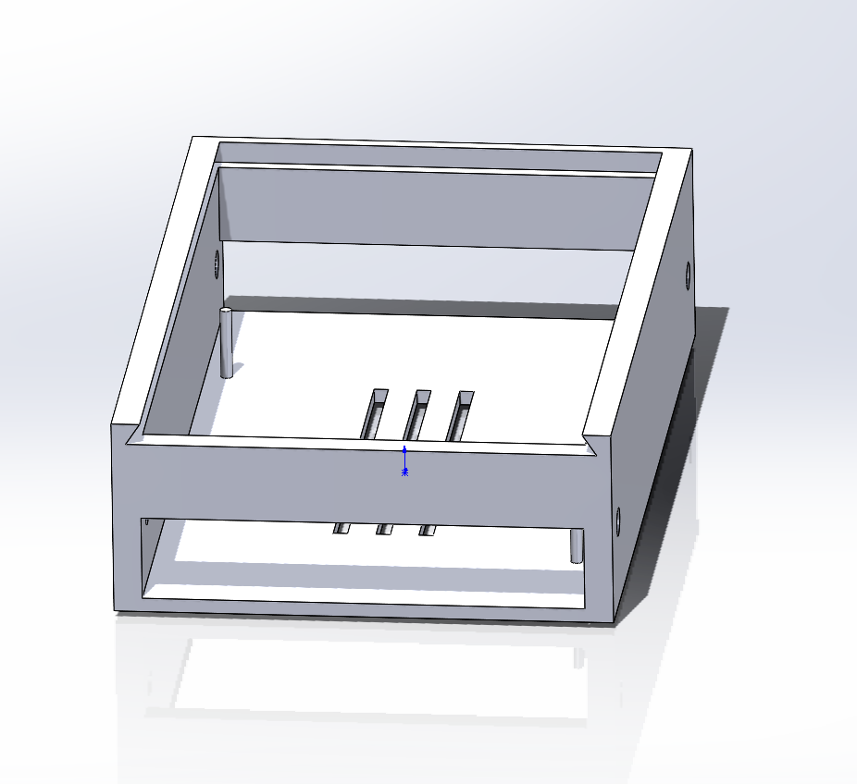
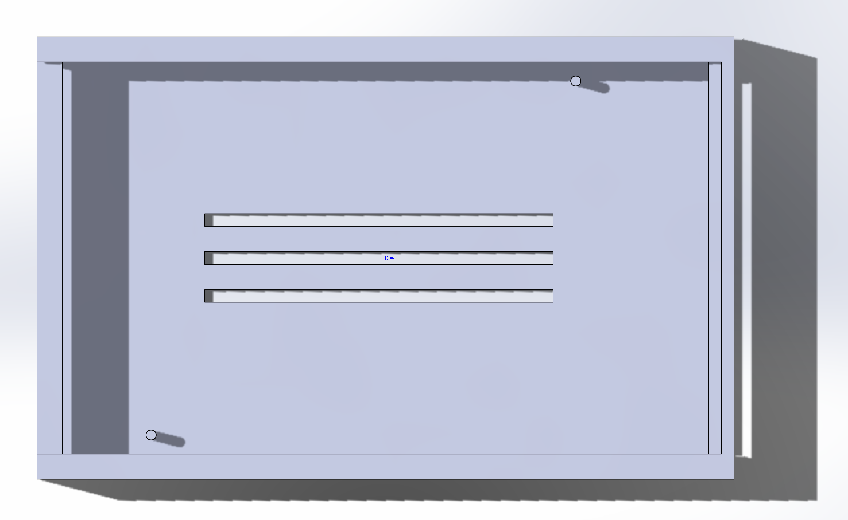
The Enclosure
Version 2

Slide 20
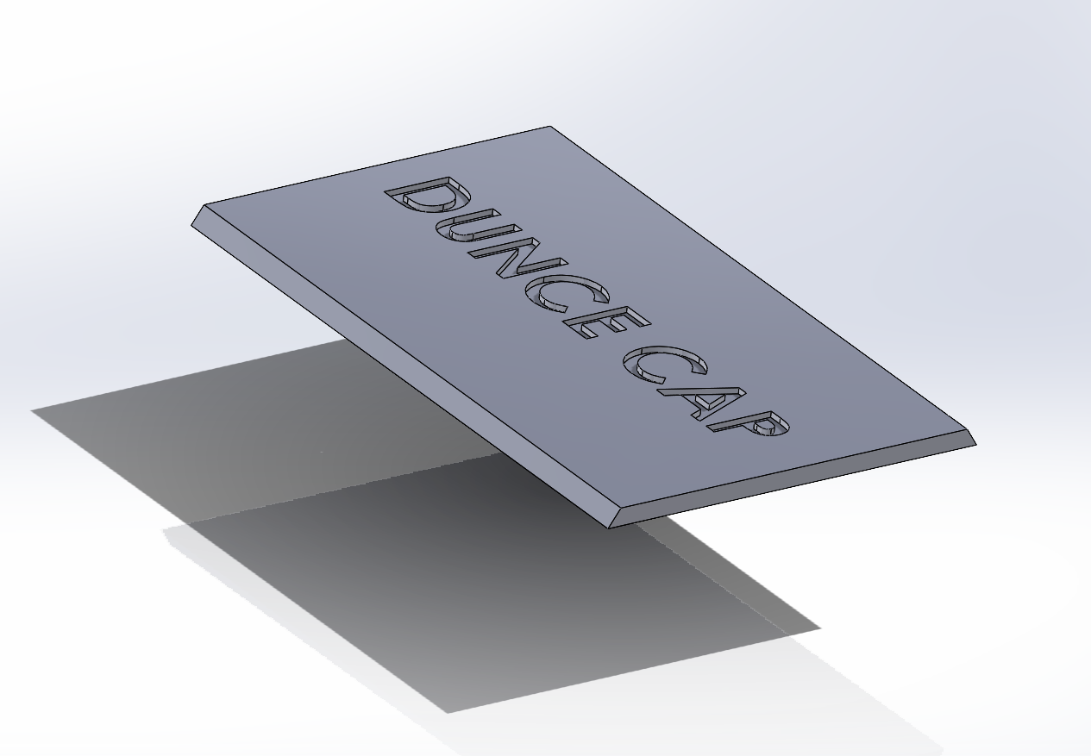

The Enclosure
Version 2

Slide 21
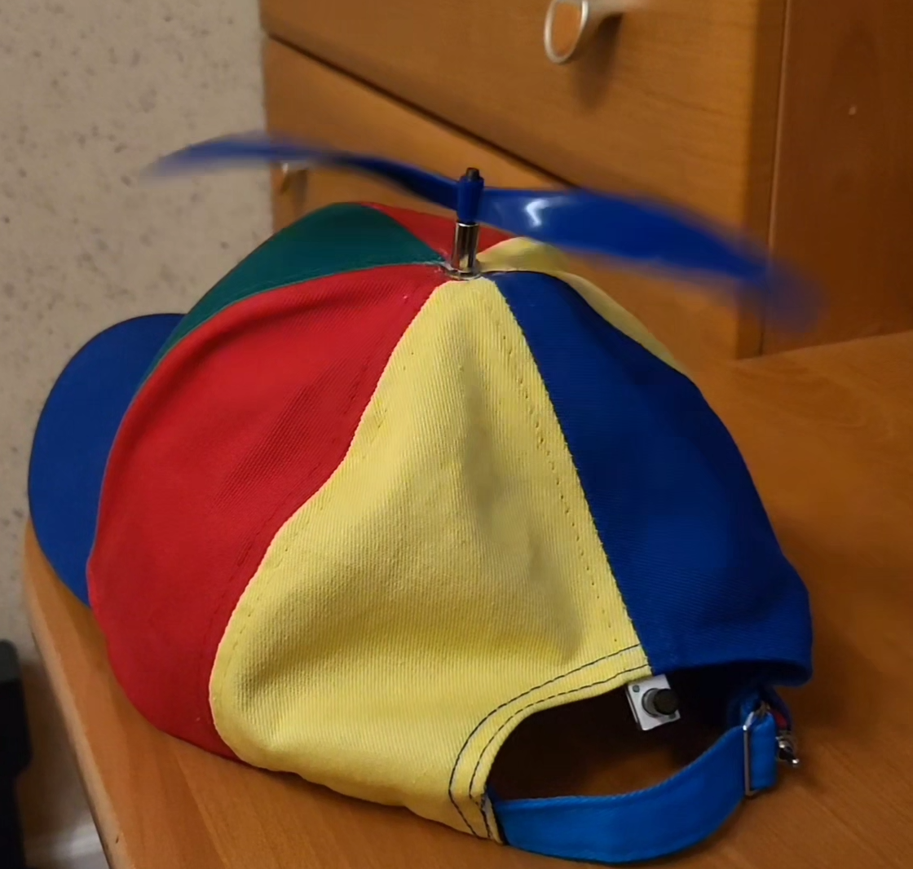
Final Product
Speed control dial
Power Switch

